Slide 1
Chapter 6
Modelling Themes

Slide 2
Model
A model is an abstraction, a simplified representation

Slide 3
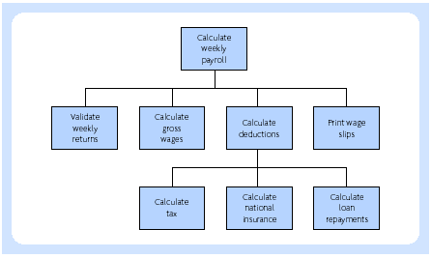
Functional decomposition

Slide 4
Data model
It is a model which is readily understandable by both developers and users because of its graphical form
It is independent of any physical implementation, i.e. it is at a logical level
It does not show bias towards particular users or departmental views. The data model can reflect a variety of different views of the data

Slide 5
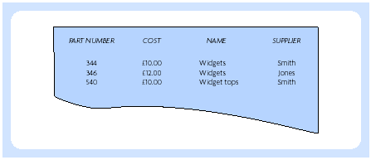
Part relation

Slide 6
Object model
Object-oriented concepts unify many aspects of the information systems development process represents data, processes, people and so on, all as objects
It facilitates the realistic re-use of software code and therefore makes application development quicker and more robust
It integrates methods of systems development with the systems context

Slide 7
Object model (Coad & Yourdon)
1. The ability to tackle more challenging problem situations because of the understanding that the approach brings to the problem situation
2. The improvement of analyst-user relationships, because the approach can be understood by both equally and because it is not computer-oriented
3. The improvement in the consistency of results, because it models all aspects of the problem in the same way
4. The ability to represent factors for change in the model so leading to a more resilient model

